Slide 1

High Dimensional Space and Normal distribution
Aishwarya,Anamika,Anurag and Pradyumna
Foundation of data science - Group-1

Slide 2
Why we are talking about High dimensions
In many applications data is in the form of vectors. In other applications, data is not in the form of vectors, but could be usefully represented by vectors.
A document is represented by a vector, each component of which corresponds to the number of occurrences of a particular term in the document.
The English language has on the order of 25,000 words or terms, so each document is represented by a 25,000 dimensional vector.
A collection of n documents is represented by a collection of n vectors, one vector per document.

Slide 3
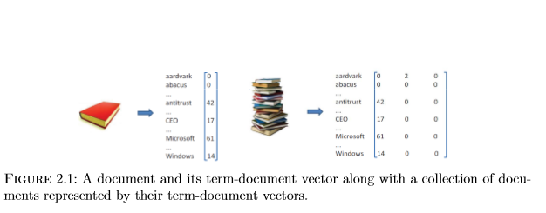
The vectors may be arranged as columns of a 25,000×n matrix.
Even this ‘n’ can be large , let’s say , 100 then our data is R¹⁰⁰ space.
Please explain the question or problem that you investigated

Slide 4
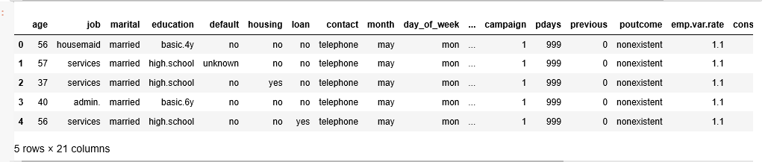
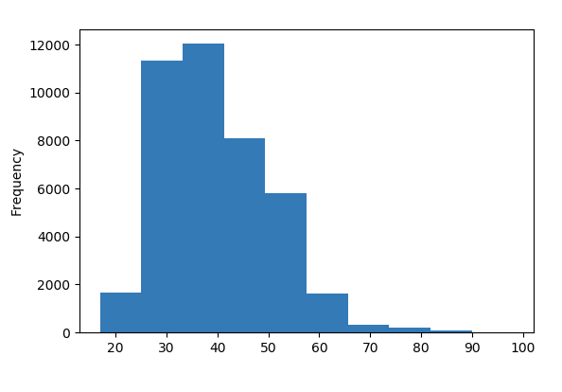
But before talking about data in high dimension let’s take a dataset:
It’s Single feature, age , can be plotted easily using histogram:
It’s data in 1-D

Slide 5
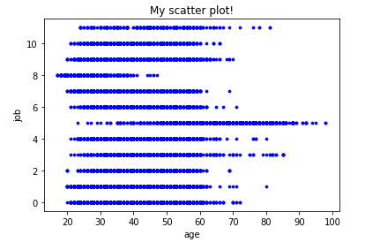
and plot its any two features, Age and Job: Data in 2-D:

Slide 6
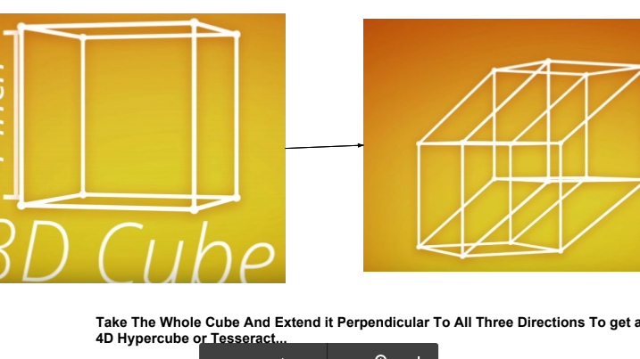
Visualisation in higher dimensions are often incomprehensible and tricky
1D :Line 2D : Square
3D :Cube 4D : Hypercube/Tesseract

Slide 7
Properties of HD space:
Our intuition about space was formed in two and three dimensions and is often misleading in high dimensions.
Consider placing 100 points uniformly at random in a unit square. Each coordinate is generated independently and uniformly at random from the interval [0, 1].
Select a point and measure the distance to all other points and observe the distribution of distances. Then increase the dimension and generate the points uniformly at random in a 100-dimensional unit cube.

Slide 8
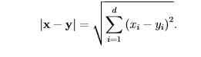
The distribution of distances becomes concentrated about an average distance.
The reason is easy to see. Let x and y be two such points in d-dimensions. The distance between x and y is
Since, is the summation of a number of independent random variables of bounded variance, by the law of large numbers the distribution of |x−y|2 is concentrated about its expected value.

Slide 9
Law of Large Nos:
The law generally states that sample mean M_{n} converges to the true mean or population mean μ as n tends to infinity.
We will prove this law by Chebyshev’s inequality which in turn will be proved by Markov’s inequality.
Before that let’s brush up our fundamentals:
X₁,X ₂ ,X₃ …… X_{n} is a sequence of independent and identically distributed (i.i.d) random variables mean μ and variance σ².

Slide 10
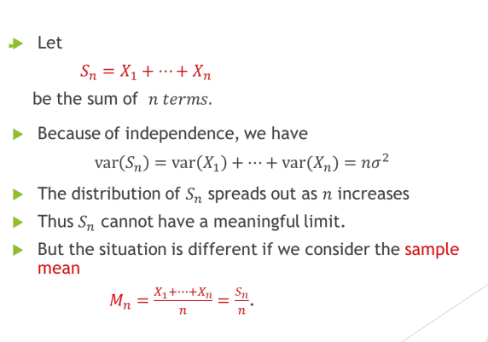

Slide 11
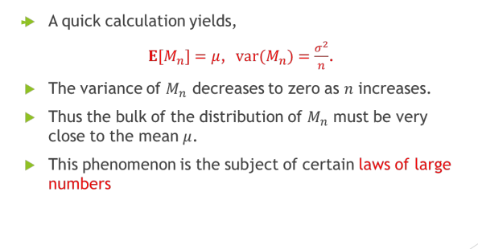

Slide 12
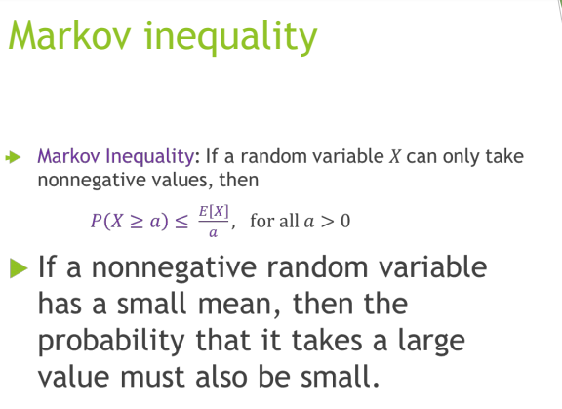
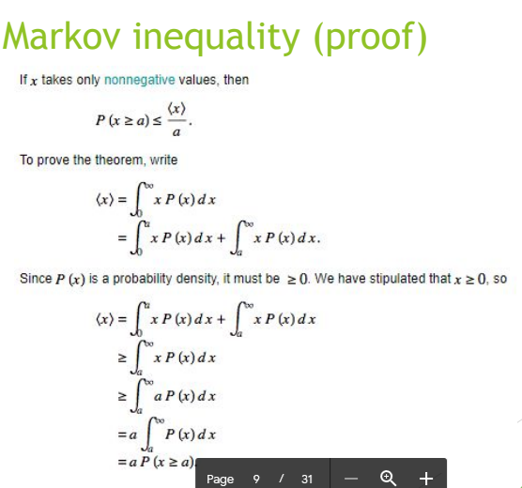

Slide 13
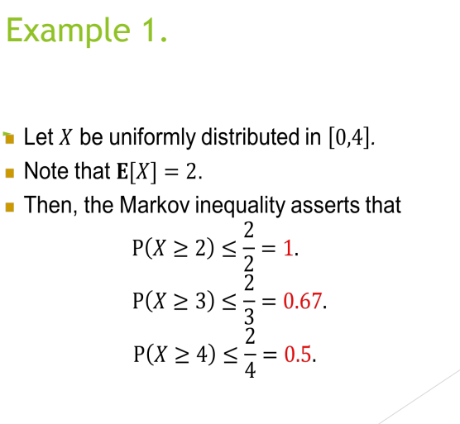
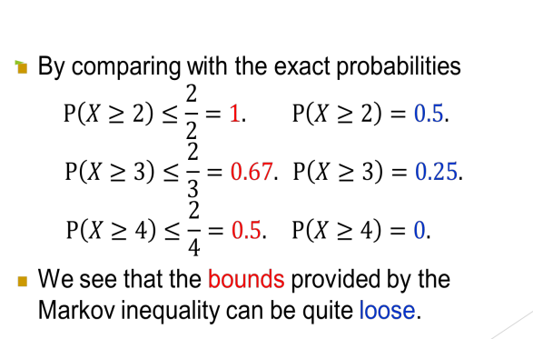

Slide 14
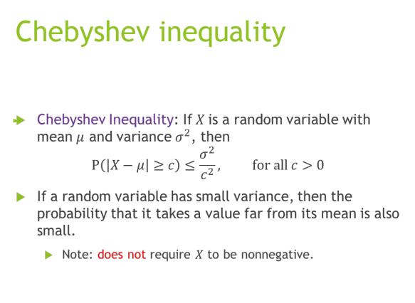
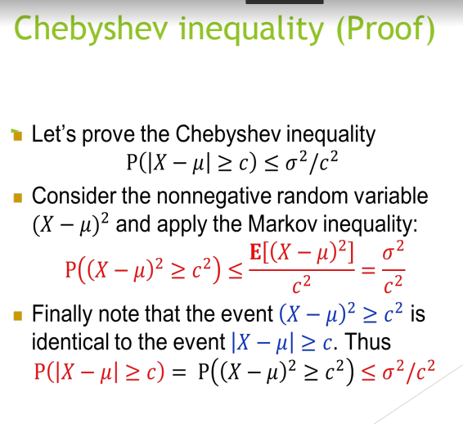

Slide 15
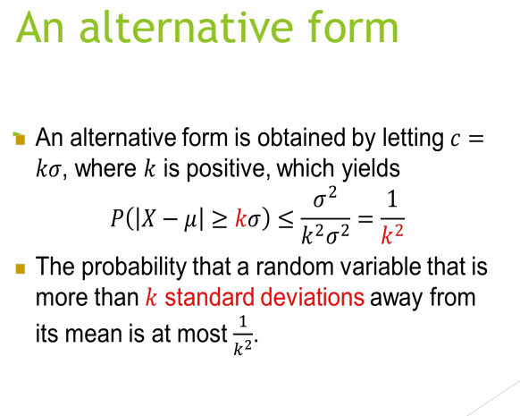

Slide 16
Central Limit Theorem
The Central Limit Theorem (CLT) is a statistical theory states that given a sufficiently large sample size from a population with a finite level of variance, the mean of all samples from the same population will be approximately equal to the mean of the population.

Slide 17
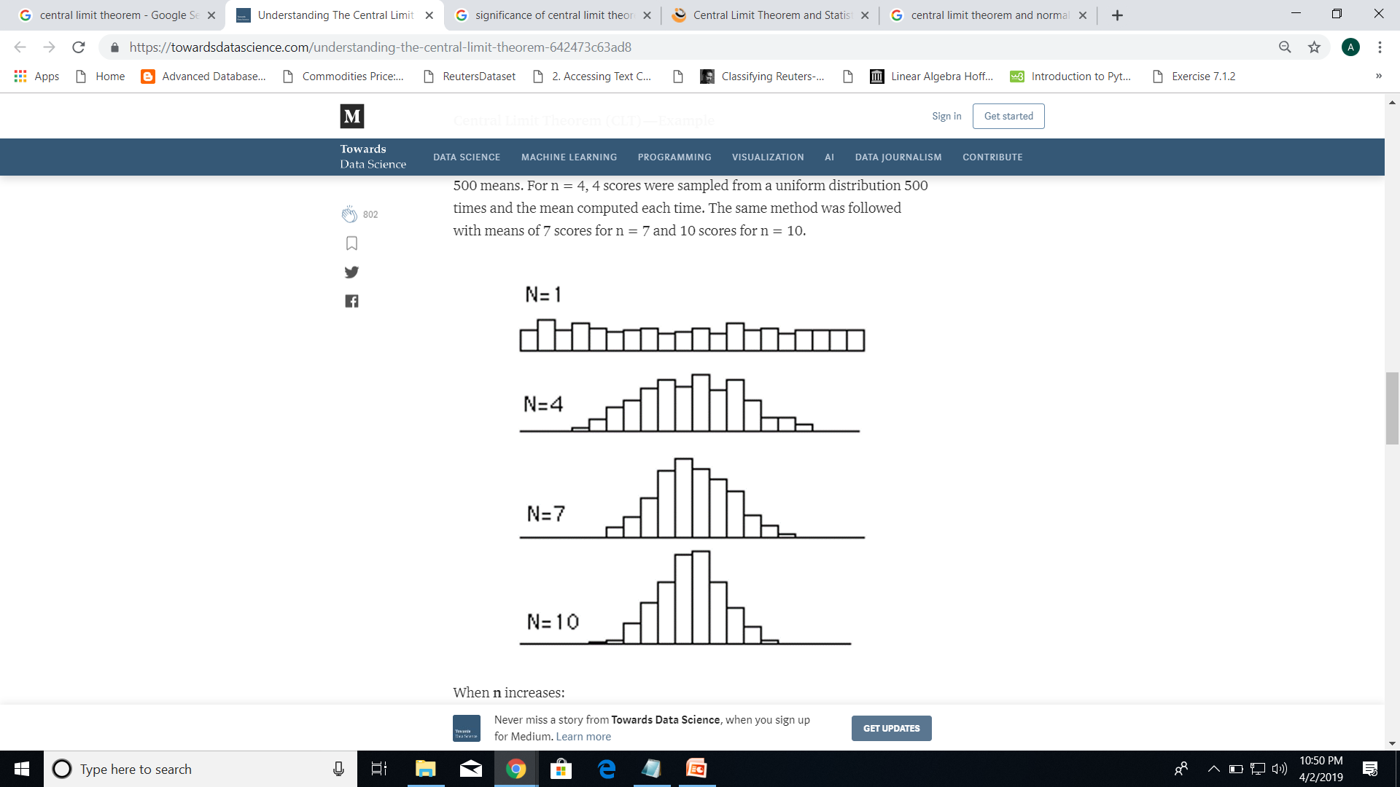

Slide 18
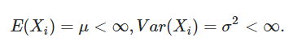
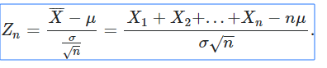
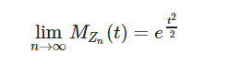
Mathematically
Let X1, X2,...,Xn are iid random variable with
Now let,
Then according to clt,

Slide 19
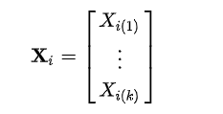
Multidimensional CLT
For High dimension data,X_{i} is a random vector in ℝ^{k}, with mean vector μ = E(X_{i}) and covariance matrix Σ
Let,
Then,

Slide 20
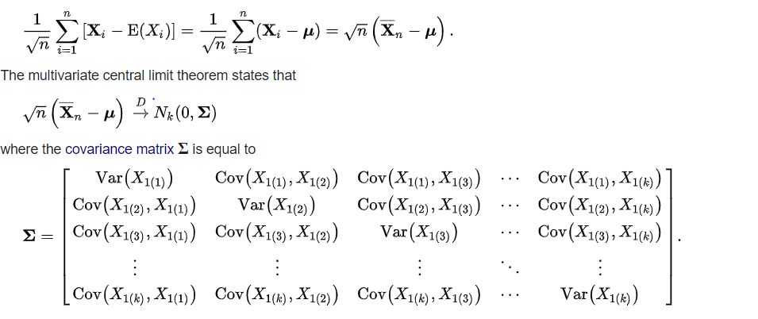

Slide 21
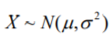
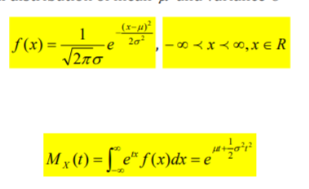
Normal Distribution
Univariate Normal Distribution:
If X is a random variable which follows normal distribution then it can be represented as:
Probability distribution Function
Moment generating Function

Slide 22
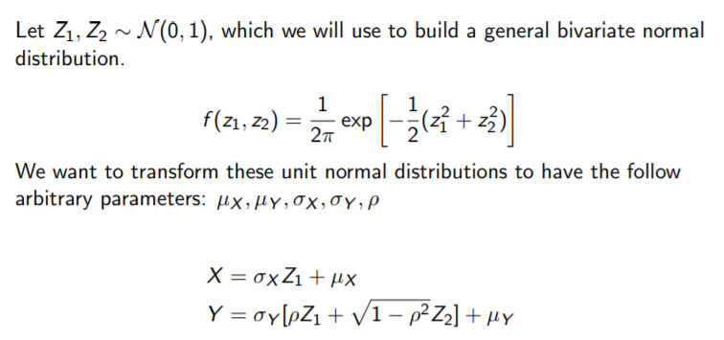
2) Bivariate Normal Distribution:

Slide 23
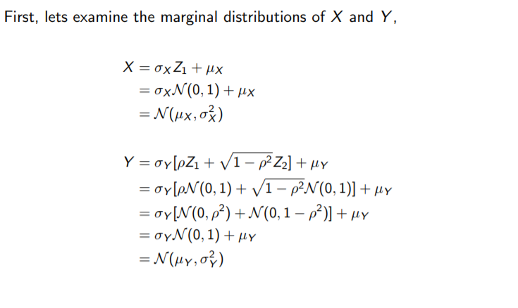

Slide 24
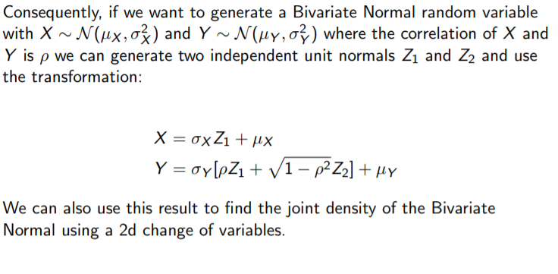

Slide 25
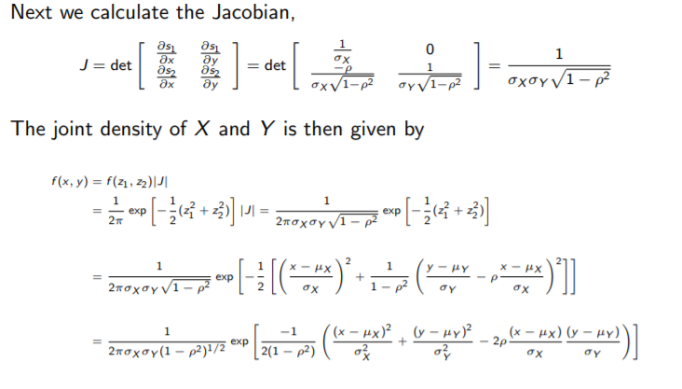
Complex Term

Slide 26
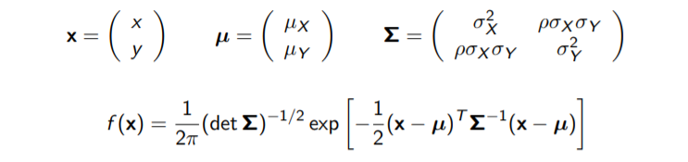

Slide 27
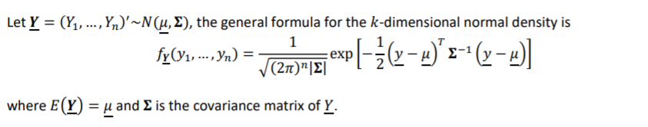
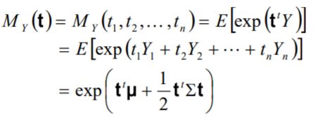
3) Multivariate Normal Distribution:
Generalisation of Bivariate Normal Distribution.

Slide 28
The mechanism behind all this :
Linear Algebra
The following things i would like to explain in context of machine learning :
Data-points as Vectors and Features as Dimensions
Dot product of Data-points
Matrices as transformation
Determinants as Scaling and Orientation measure
Inverse as Undo tool
Eigenvalues and Eigenvectors as Invariants under Transformation
Orthogonality as a requirement of Features Selection
Matrix decomposition as Dimension reduction tool

Slide 29
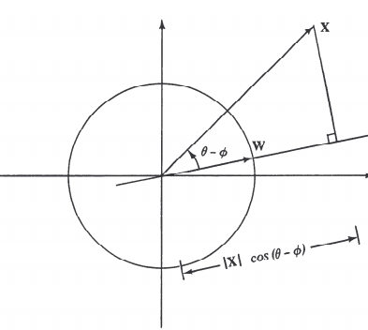
Dot product as projection :-
Dot product as projection

Slide 30
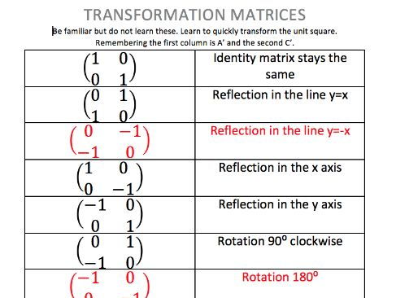
Matrix as transformations

Slide 31
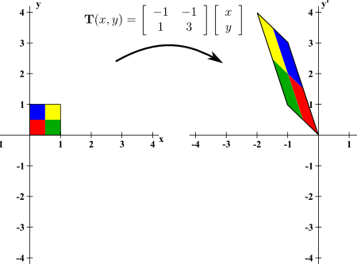
Determinants as scaling and orientation measures of transformation

Slide 32
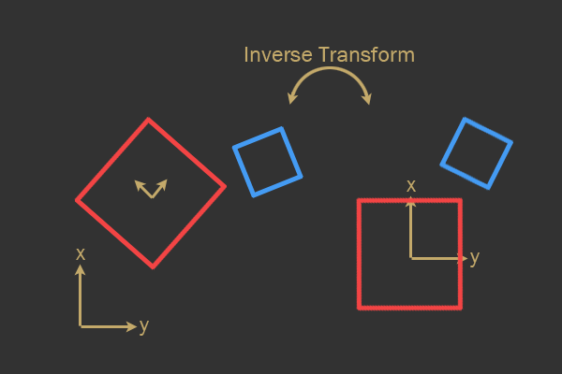
Inverse as our undo tool

Slide 33
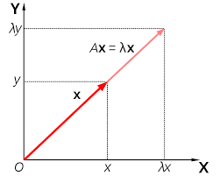
Eigen Values and Eigen Vectors as Invariants under Transformation

Slide 34
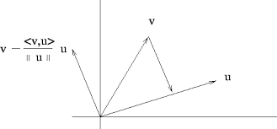
Orthogonality as a requirement of Features Selection

Slide 35
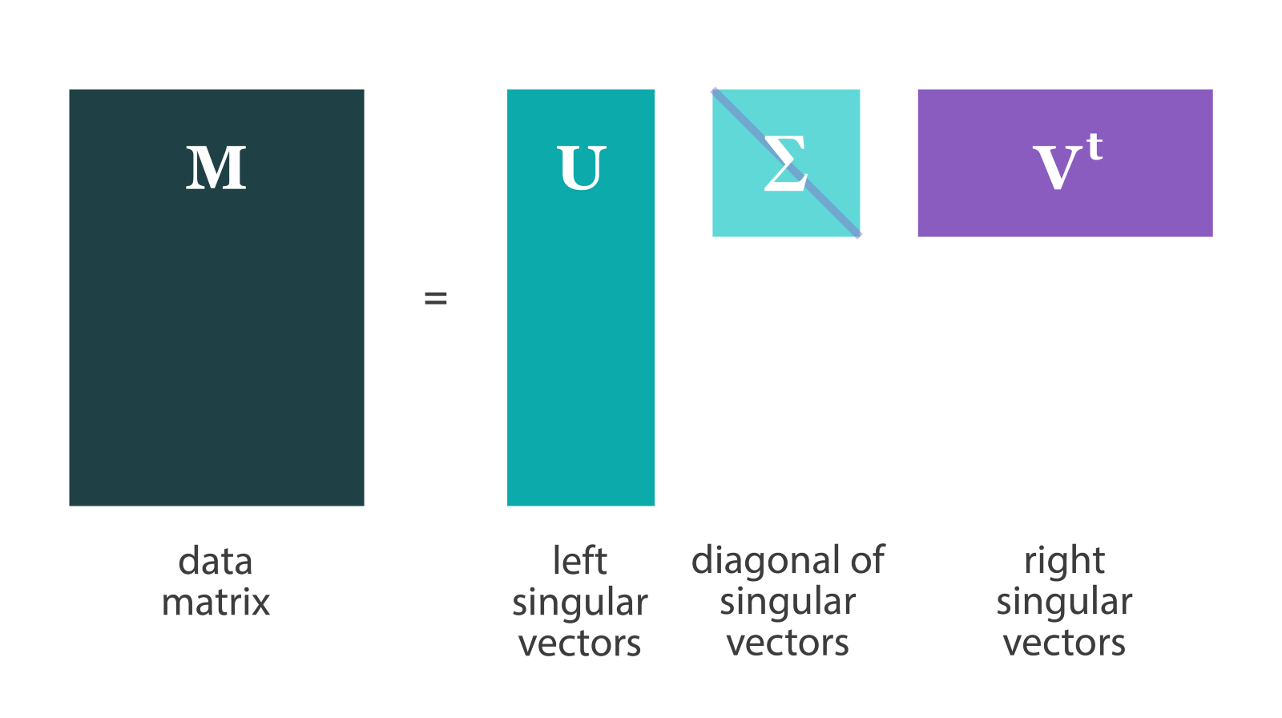
Matrix Decomposition as Dimension reduction tool

Slide 36
THANK YOU

